Slide 1
Hamming Code
Prepared by
Prof. Hitesh Dholakiya
Modified by
Rifat Rahman
Assistant Professor
Institute of Appropriate Technology, BUET

Slide 2
Hamming Code
Basics of Hamming Code
It is given by RW Hamming
It is used to detect and correct errors.
In Hamming Code, Codeword = Data bits + Parity bits
It is represented by (n,k) code
Where, n = Total bits and k = message bits
Parity bits p = n – k

Slide 3
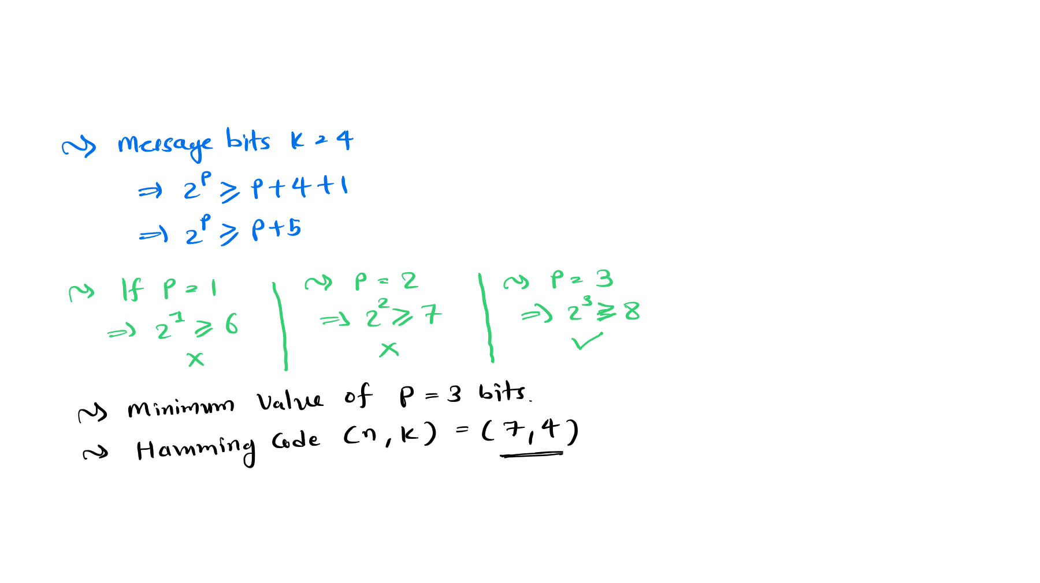
Parity bits condition in Hamming Code
To identify Parity bits, it should satisfy the given condition.
∴ 𝟐^{𝐏} ≥ 𝐩 + 𝐤 + 𝟏

Slide 4
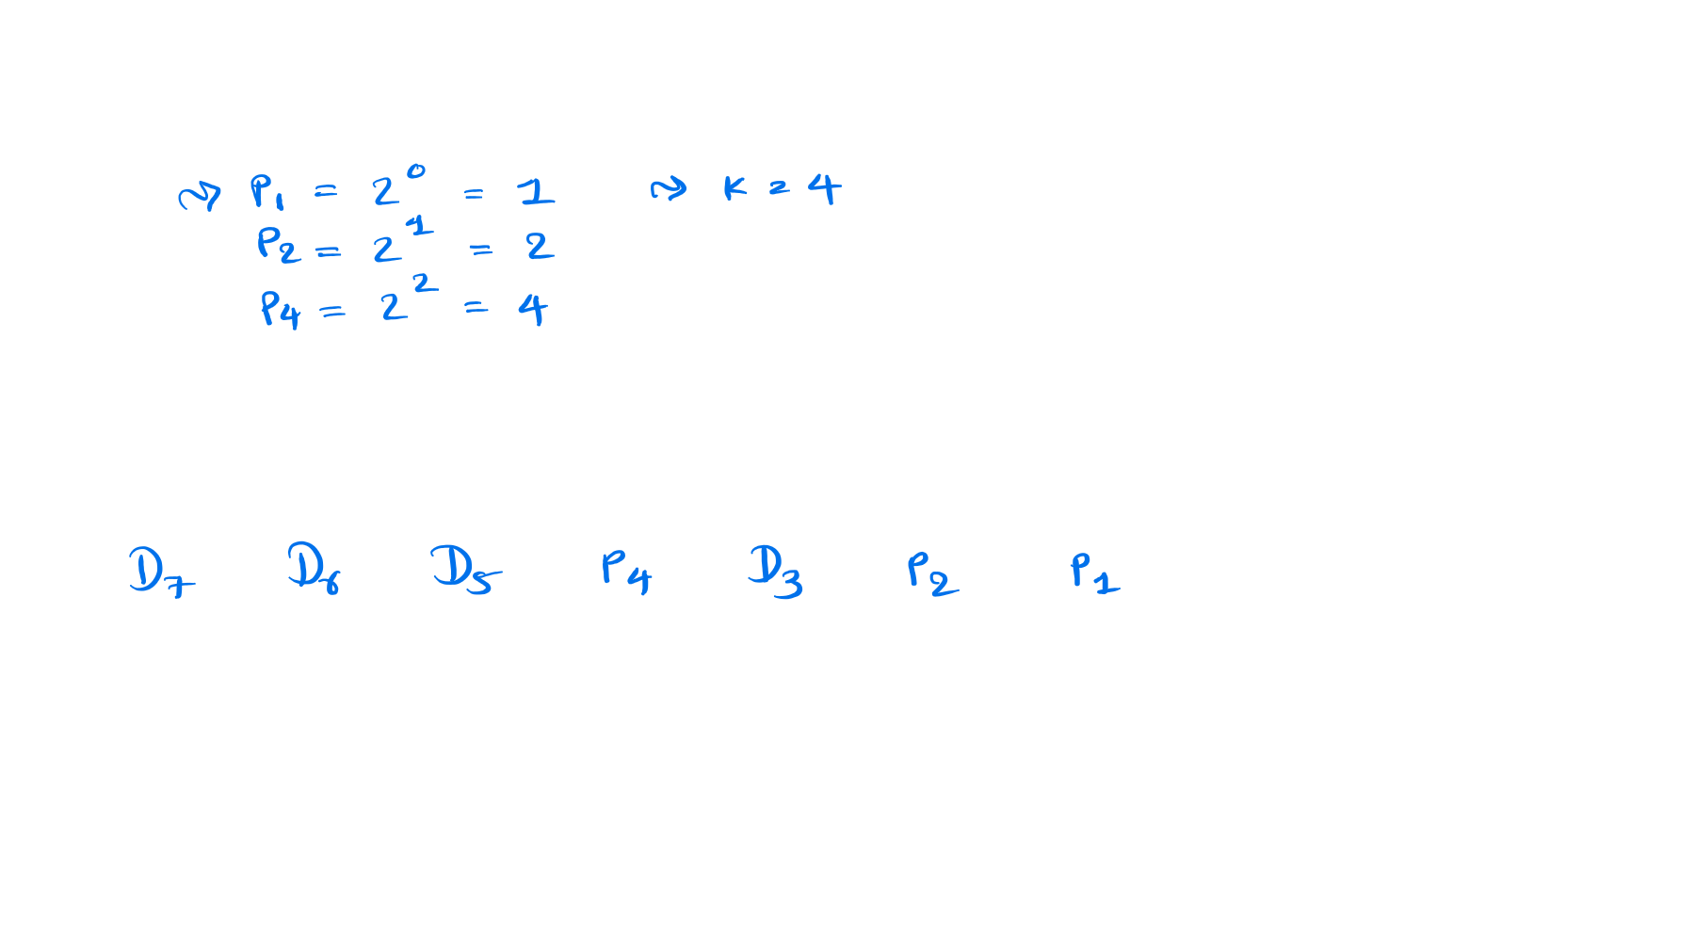

Position of Parity bits & Message bits in Hamming Code
Let’s take an example of (7,4) hamming code.
Bit Positions
7 6
5
4
3
2
1

Slide 5
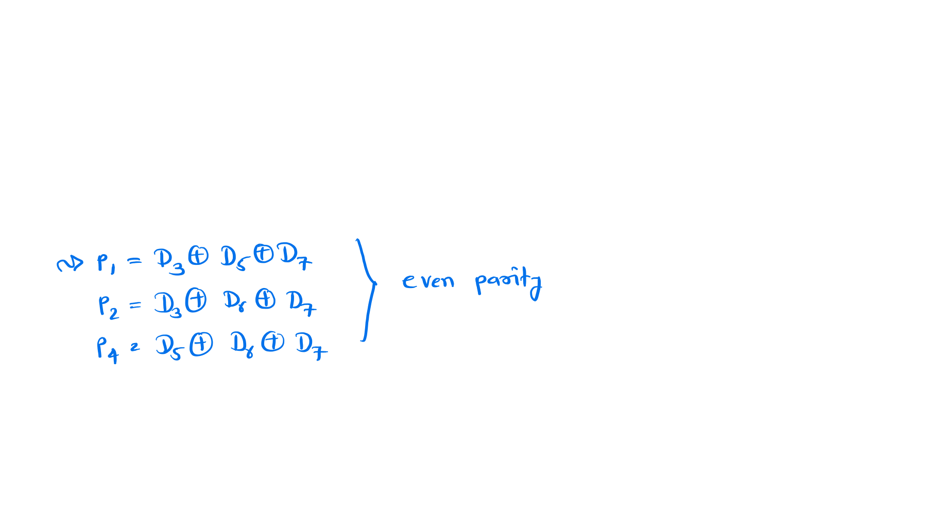
Calculation of Parity bits in Hamming Code
Let’s take an example of (7,4) hamming code.
Bit Positions
7 6
5
4
3
2
1
D7 | D6 | D5 | P4 | D3 | P2 | P1

Slide 6
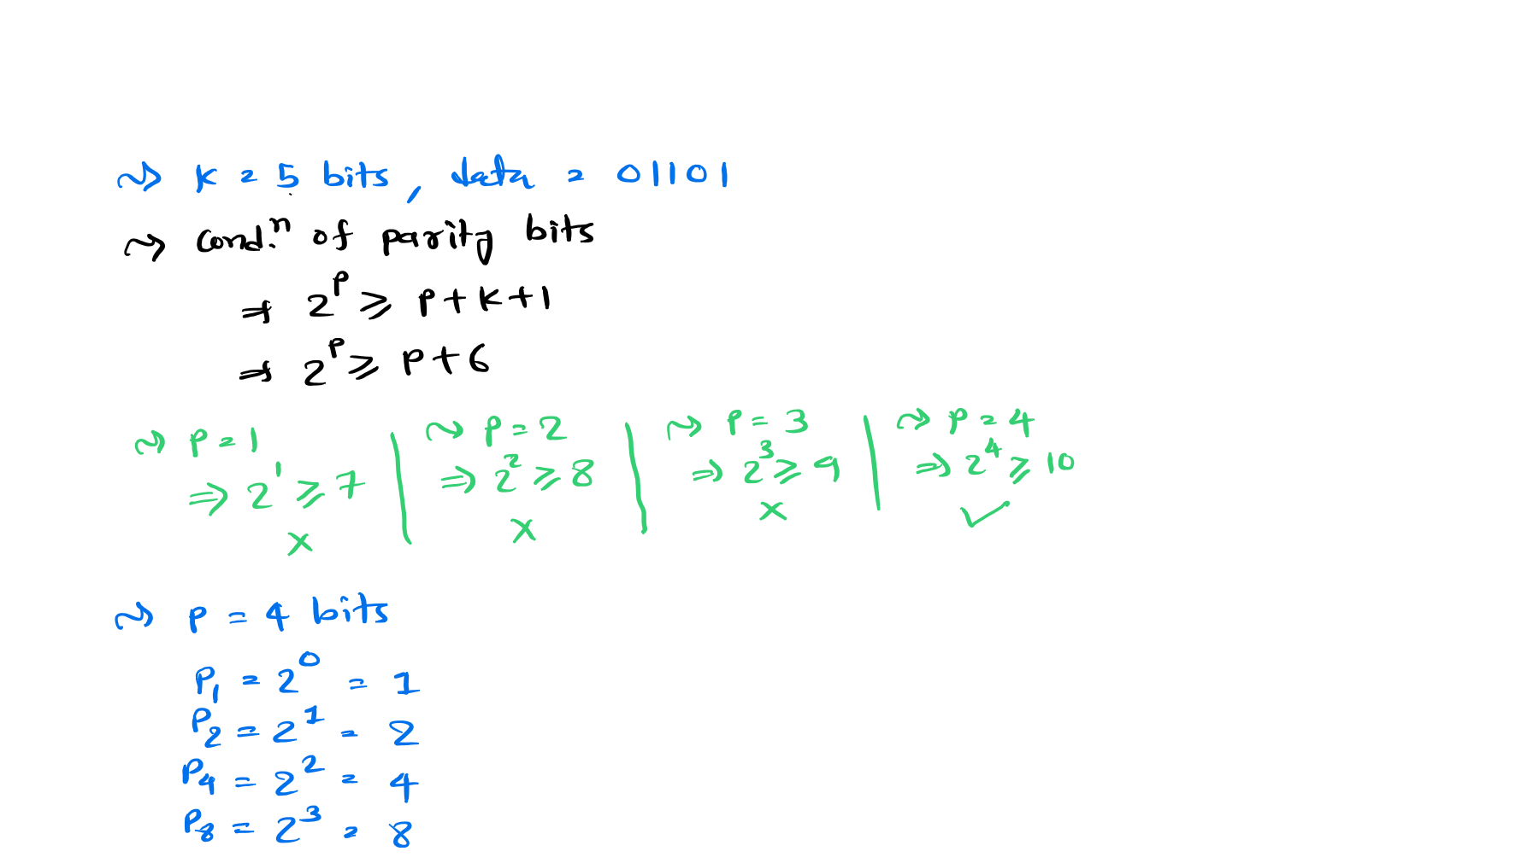
Generation of Hamming Code
If 5 bits data 01101 is given. Represent given data in hamming code.

Slide 7
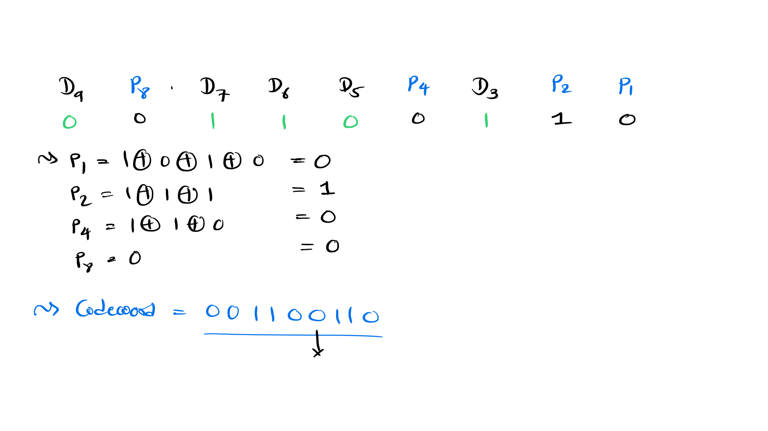

Bit Positions
9 8
7
6
5
4
3
2
1

Slide 8
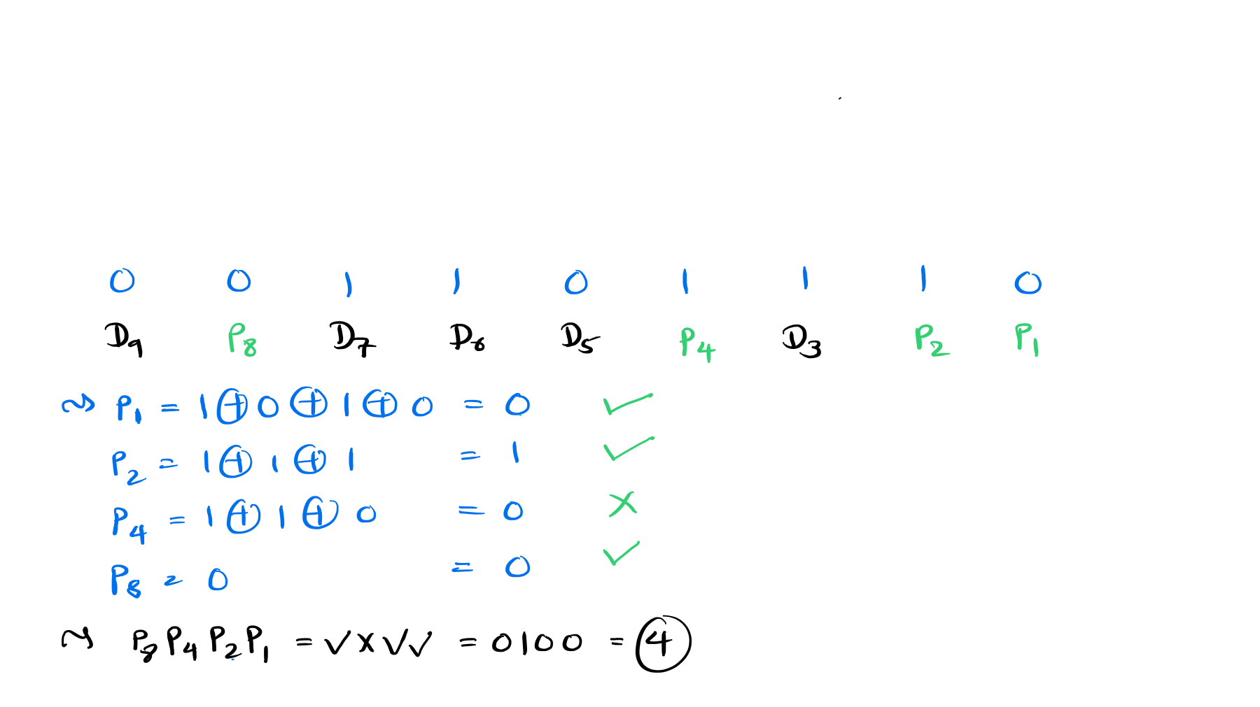

Error Detection and Correction by Hamming Code
If the received code as per Hamming code is 001101110. then find error in received
codeword.
Bit Positions
9 8 7 6 5 4 3 2 1

Slide 9
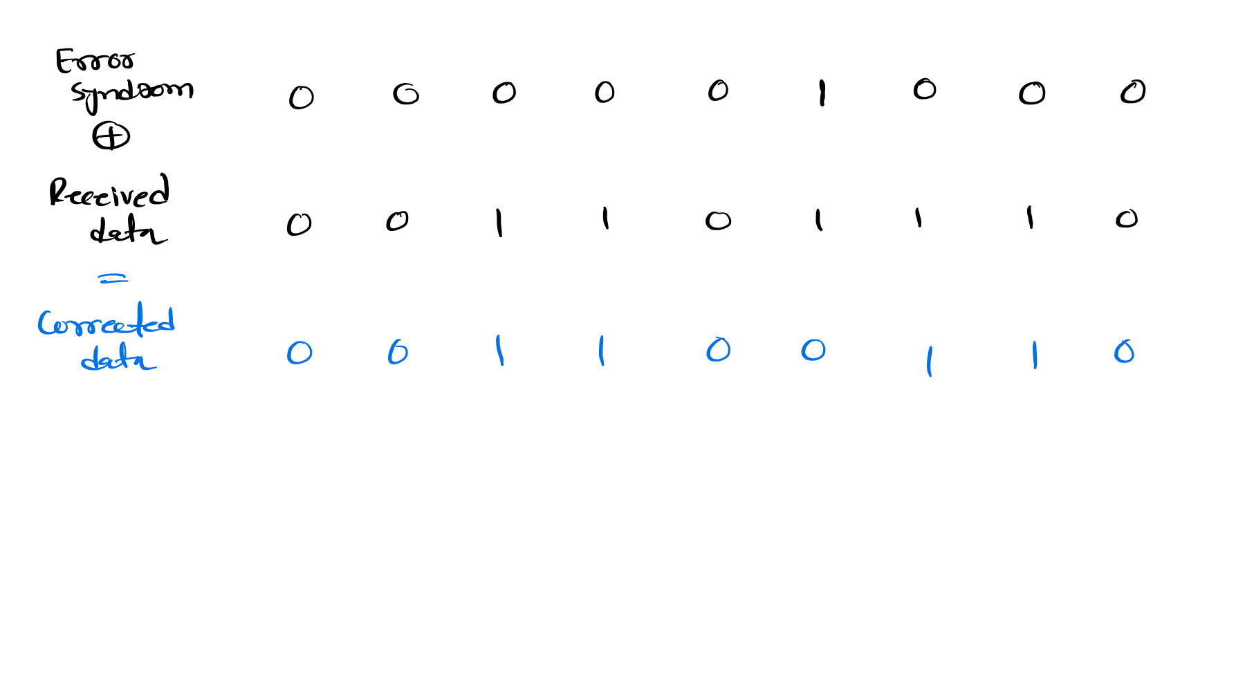






9 | 8 | 7 | 6 | 5 | 4 | 3 | 2 | 1
9 | 8 | 7 | 6 | 5 | 4 | 3 | 2 | 1
9 | 8 | 7 | 6 | 5 | 4 | 3 | 2 | 1

